Slide 1

Chapter 7
Families
SOC 2020
Sixth Edition

Slide 2
What’s to Come?
Defining Family.
Dating, Mating, and Parenting.
Modern Families.
Divorce.

Slide 3
As You Read
What do we mean by family?
How do people pick partners?
How do families vary?

Slide 4
Defining Family
Families around the world come in many shapes and sizes.
Cross-cultural variation in family structure supports the sociological principle that culture is socially constructed.
Including our beliefs and practices about families.
Sociologists have developed two approaches to defining families.
Substantive definition focusing on what a family is.
Functional definition focusing on what families do.

Slide 5
Substance: What a Family Is 1
Substantive definition of the family: a definition of families in terms of blood, connecting people biologically, and law, connecting people through formal social recognitions.
The primary advantage of this approach is that boundaries are clear.
We can tell who is in and who is out.
This makes it easier to count families—such as what is done by the U.S. Census.

Slide 6
Substance: What a Family Is 2
Kinship Patterns.
Kinship: the state of being related to others.
Bilateral descent: both sides of a person’s family are regarded as equally important in determining kinship.
Patrilineal descent: only the father’s relatives are significant in terms of property, inheritance, and emotional ties.
Matrilineal descent: only the mother’s relatives are significant.

Slide 7
Substance: What a Family Is 3
Marriage Types.
Monogamy: a form of marriage in which two people are married only to each other.
Serial monogamy: a form of marriage in which a person has several spouses in his or her lifetime, but only one spouse at a time.
Polygamy: a form of marriage in which an individual may have several husbands or wives simultaneously.
Polygyny: a form of polygamy in which a man may have more than one wife at the same time.
Polyandry: a form of polygamy in which a woman may have more than one husband at the same time.

Slide 8
Substance: What a Family Is 4
Family Networks.
Extended family: a family in which relatives—such as grandparents, aunts, or uncles—live in the same or adjacent households as parents and their children.
Historically, extended families were the norm.
Nuclear family: a married couple and their unmarried children living together.
This family structure became more common as the Industrial Revolution changed economies and social dynamics.

Slide 9
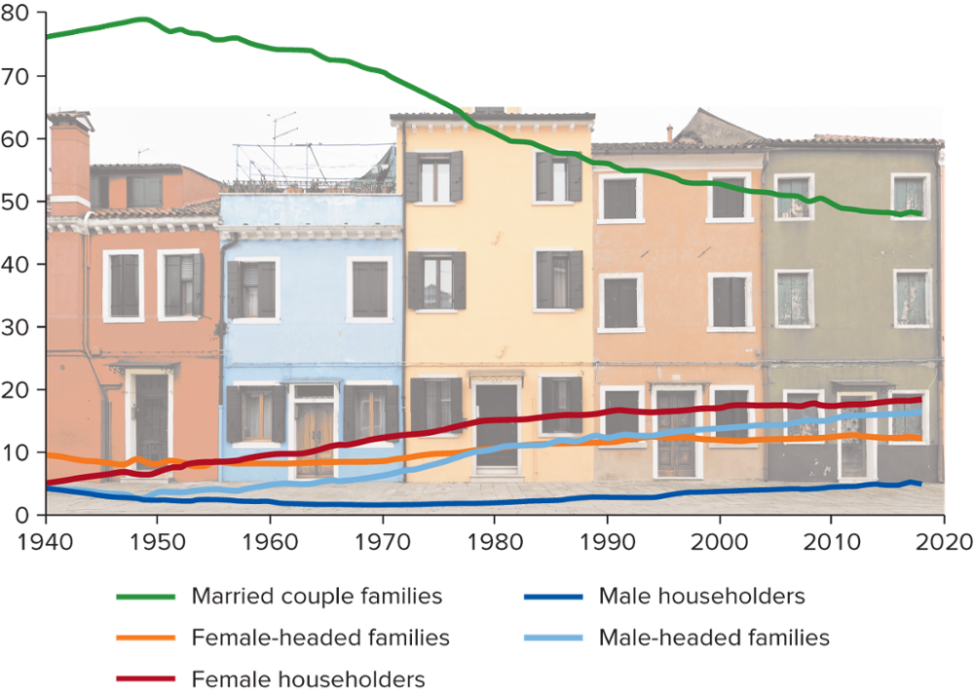
U.S. Households by Family Type, 1940 to 2018
Note: Male and female householders include men and women living alone or exclusively with people to whom they are not related, including those in a college dormitory, homeless shelter, or military base. Source: U.S. Census Bureau 2018d:Table HH-1. Photo: S. Greg Panosian/Getty Images
Access the text alternative for slide images.

Slide 10
Functions: What Families Do
Functionalist definition of families: a definition of families that focuses on how families provide for the physical, social, and emotional needs of individuals and of society as a whole.
Six primary functions of families identified by William F. Ogburn:
Reproduction.
Socialization.
Protection.
Regulation of sexual behavior.
Affection and companionship.
Provision of social status.

Slide 11
Conflict: Who Rules?
Patriarchy: a society in which men dominate in family decision making.
Matriarchy: a society in which women dominate in family decision making.
Egalitarian family: an authority pattern in which spouses are regarded as equals.
Families serve as the basis for transferring material, social, and cultural resources from one generation to the next.

Slide 12
Marriage, Mating, and Parenting
Historian Stephanie Coontz suggests marriage today is better than ever.
Shared decision making and housework.
Increases in time spent with children.
Declines in violence and sexual coercion and in the likelihood of adultery.

Slide 13
Marriage Trends
Almost 80% of Americans aged 25 and older are, or have been, married.
The marriage rate is nevertheless at or near a record low.
In recent decades, Americans have been waiting longer before getting married for the first time.
In the past, marriage was often seen as a cornerstone on which to start an adult life.
Now it is more often considered a capstone, a sign that one’s education is done and one’s career is established.

Slide 14
Courtship and Mate Selection 1
Historically, it was not uncommon for marriages to be arranged by families or matchmakers.
This practice continues in some cultures today.
In the United States, most of us assume true love will guide the way.
Online dating has become common.
Research reveals we aren’t always honest in how we present ourselves.

Slide 15
Courtship and Mate Selection 2
Even with online dating, the pool of potential partners is substantially reduced by our social location.
We are limited to those who are available and with whom we have contact.
We are heavily influenced by others’ opinions.
We are most attracted to people like ourselves.

Slide 16
Courtship and Mate Selection 3
Endogamy: the restriction of mate selection to people within the same group.
Exogamy: the requirement that people select a mate outside certain groups.
Incest taboo: the prohibition of sexual relationships between certain culturally specified relatives.
Homogamy: the conscious or unconscious tendency to select a mate with personal characteristics similar to one’s own.

Slide 17

Ten Questions Couples Should Ask (or Wish They Had) before Marrying
Do you want to have children?
Who will do what when it comes to housework?
What are your expectations regarding sex?
What do you think about having a television in the bedroom?
What do you expect regarding religious training for our children?
How much money do you owe?
Do you like and respect my friends?
What do you really think about my parents?
What does my family do that annoys you?
Are there some things you are not willing to give up in the marriage?
Source: The New York Times 2006. Photo: ©Jasper White/Image Source

Slide 18
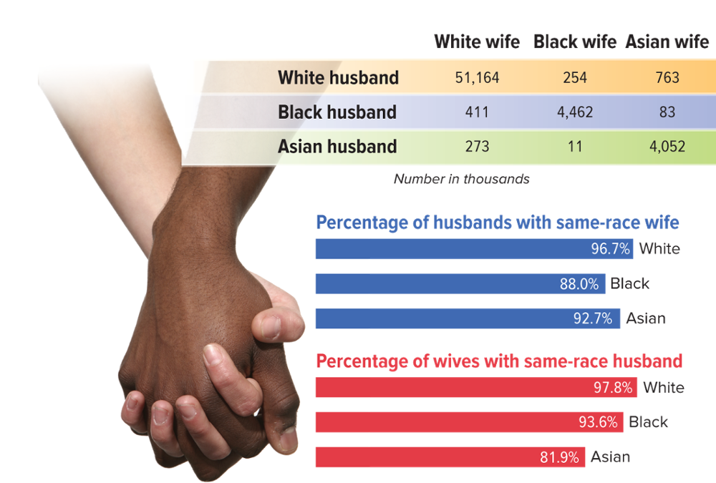
Patterns of Interracial Marriage
Note: Numbers in thousands. Table does not show data for “Other” race husbands and wives. Source: U.S. Census Bureau 2018g:Table FG3. Photo: Alexandre Zveiger/Shutterstock
Access the text alternative for slide images.

Slide 19
Parenthood Patterns and Practices 1
Caring for children is a universal function of the family, but different societies assign this function in different ways.
Births.
In the United States, a mother’s average age at first birth was 26.3 in 2016
When to have a baby is affected by education and location.
The average number of babies a woman gives birth to has declined significantly.
A woman’s median age at first birth is now younger than the median age at first marriage.

Slide 20
Parenthood Patterns and Practices 2
Adoption.
Adoption: the socially recognized and affirmed transfer of the legal rights, responsibilities, and privileges of parenthood.
Approximately 2.3% of U.S. children live with at least one adoptive parent.
Adoption of an unrelated person may be arranged through a licensed agency or through a private agreement sanctioned by the courts.
Adopted children may come from the U.S. or from abroad.
Adoption by unmarried persons is legal in all 50 states.
In 2017, 123,437 children in foster care in the U.S. were awaiting adoption.

Slide 21
Parenthood Patterns and Practices 3
Parenting.
The family is the primary agent of socialization.
Sociologist Annette Lareau identified two approaches to parenting linked to parents’ social class backgrounds.
Concerted cultivation, involving active engagement and sustained supervision in order to foster children’s growth and development, is more used by middle- and upper-middle-class parents.
Accomplishment of natural growth, where parents provide broad guidelines for behavior and allow children the freedom to navigate the world on their own, is more used by working-class and poor families.

Slide 22
Parenthood Patterns and Practices 4
Parenting, continued.
Parenting practices also differ by race and ethnicity.
For example, Mexican Americans are known for placing the interests of the family first, a value known familism.
Strong kinship ties also matter in African American families.
Parenting in Asian American families is commonly supportive.

Slide 23
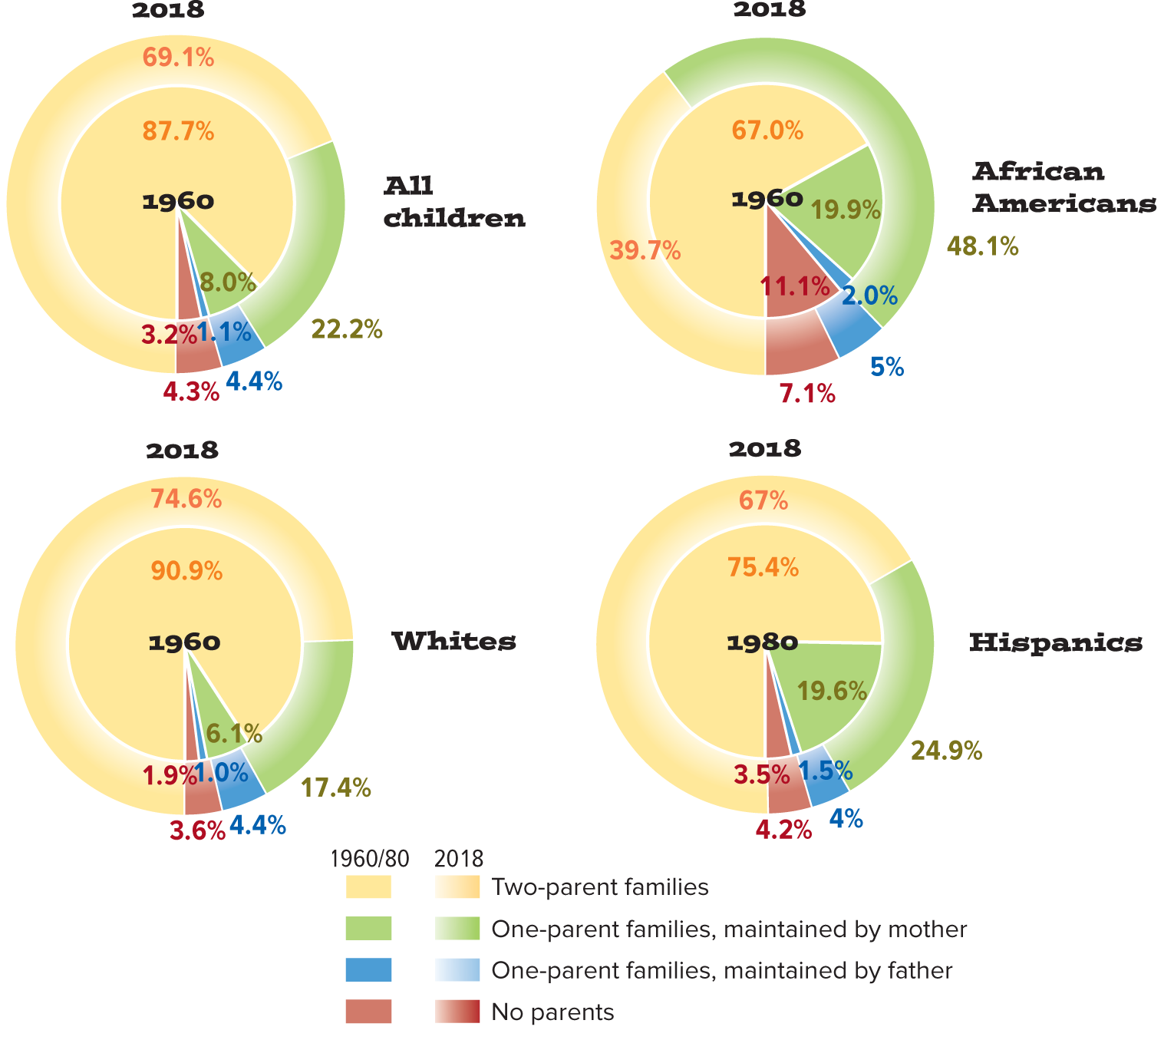
Living Arrangements of Children
Note: The “No parents” category includes children living with either other relatives or nonrelatives. Persons of Hispanic origin can be of any race. Source: U.S. Census Bureau 2018h:Tables Ch-1, Ch-2, Ch-3, Ch-4.
Access the text alternative for slide images.

Slide 24
5 Movies on Marriage and Family
Loving
A couple’s true love conquers all, even the Supreme Court.
Instant Family
The people who take in foster kids are really special.
The Princess Bride
True love will follow you forever.
Leave No Trace
A father and a daughter anchor each other’s lives.
Mudbound
Two families worked the land for generations.

Slide 25
Modern Families
Families come in many different shapes and sizes.
In order to better understand families today, sociologists have identified and investigated a number of specific family variations.
These can overlap and combine to form even more varieties.

Slide 26
Dual-Income Families
Among married couples with children under 6, 57% have both husband and wife in the labor force.
Both opportunity and need have driven the rise in the number of dual-income couples.
Women have more opportunities today, both in terms of education and in terms of occupational fields.
Couples are finding it harder to make it on a single income.
The average income per household has remained relatively flat since the early 1970s.

Slide 27
Same-Sex Marriage
Attitudes about same-sex marriage vary by age, religious affiliation, political party, race, and gender.
On June 26, 2015, same-sex marriage became legal in all 50 states.
Within two years of the Supreme Court ruling, 61% of cohabiting same-sex couples were married.

Slide 28
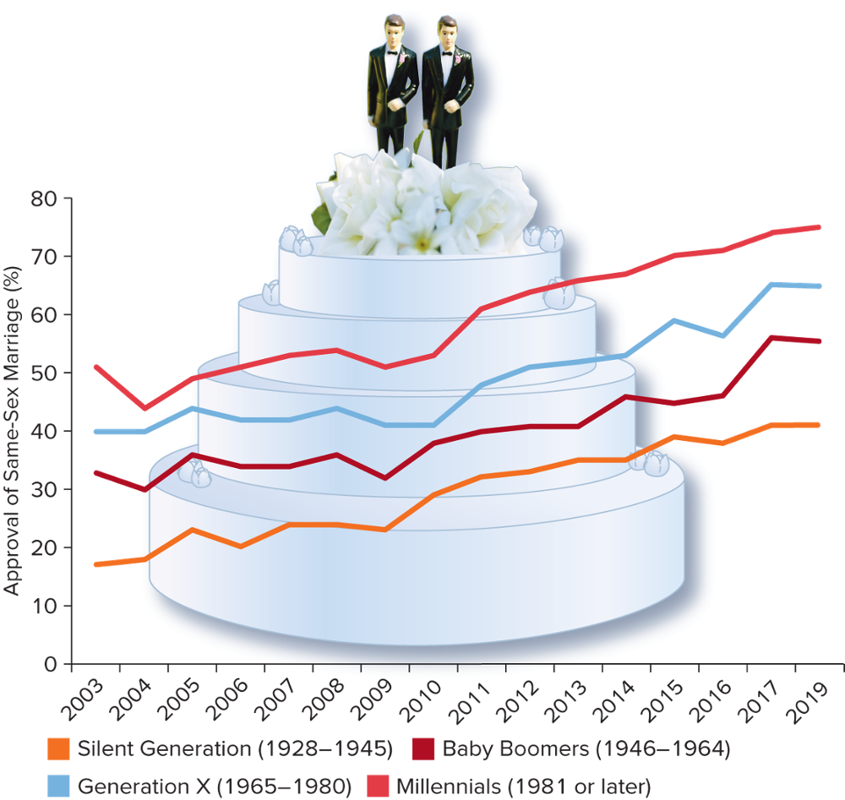
Approval of Same-Sex Marriage by Age
Note: Responses are to the question, “Do you favor allowing gays or lesbians to marry legally?” Source: Pew Research Center 2019b. Photo: Angela Wyant/The Image Bank/Getty Images
Access the text alternative for slide images.

Slide 29
Single-Parent Families
Single-parent family: a family in which only one parent is present to care for the children.
In 2018, 26.6% of U.S. children lived with only one parent.
This varied by race and ethnicity.
Life in the single-parent family can be stressful, particularly when the single mother is a teenager.
Although 83% of single parents in the U.S. are mothers, the number of households headed by single fathers has more than quadrupled since 2018.

Slide 30
Stepfamilies 1
Approximately 4.1% of children under 18 live with at least one stepparent.
Sociologist Susan Stewart suggests expanding our conception of stepfamilies.
Cohabiting couples with children from previous relationships.
Families whose stepchildren do not live with them full-time.
Gay or lesbian couples with children from former heterosexual relationships.
Stepfamilies with adult children.

Slide 31
Stepfamilies 2
Family members in stepfamilies often deal with resocialization issues.
Standards can decline in families with stepparents.
Children raised in families with stepmothers are likely to have less health care, education, and money spent on their food.

Slide 32
Multigenerational Families
Multigenerational households have two or more adult generations, or grandparents with grandchildren younger than 25.
The percentage of such households in the U.S. has recently been on the rise.
The recent surge has been driven by young adult children living with their parents.
Prompted by limited job opportunities with low starting salaries and significant student loan debt.

Slide 33
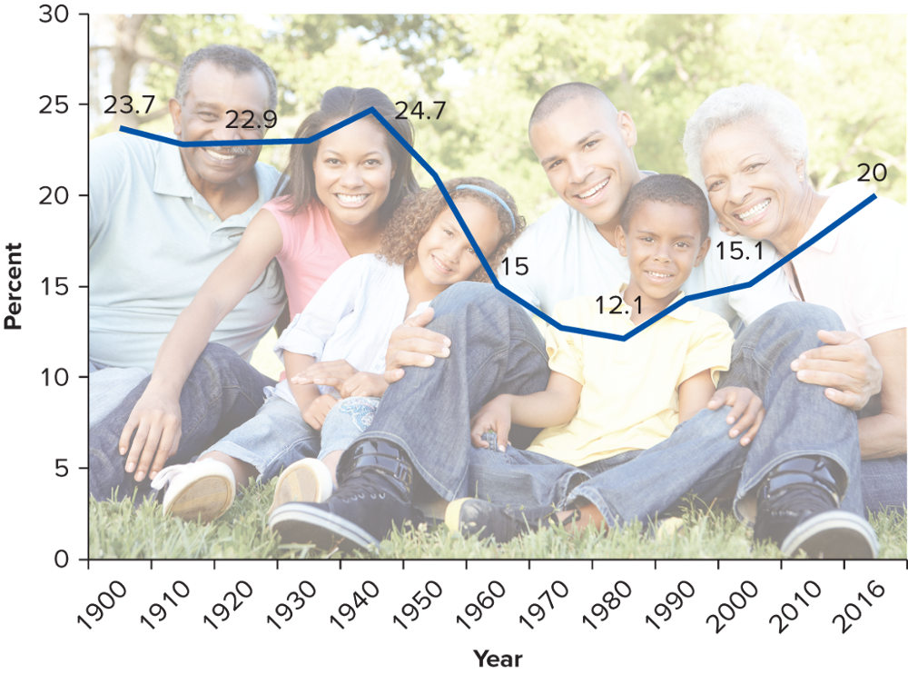
Population in Multigenerational Households
Note: Multigenerational households are defined as including two or more adult generations (if including parents and children, children must be 25 and older), or grandparents with grandchildren younger than 25. Sources: Cohn and Passel 2018; Fry and Passel 2014; Pew Research Center 2010:Table 1. Photo: Cathy Yeulet/stockbroker/123RF
Access the text alternative for slide images.

Slide 34
Cohabitation
Cohabitation: two adults living in a committed relationship with an unmarried partner.
Overall, 7% of U.S. adults are cohabiting.
About half of all currently married couples in the U.S. say they lived together before marriage.
More common among African Americans and American Indians, and least common among Asian Americans.
Cohabitation is especially common in Europe.

Slide 35
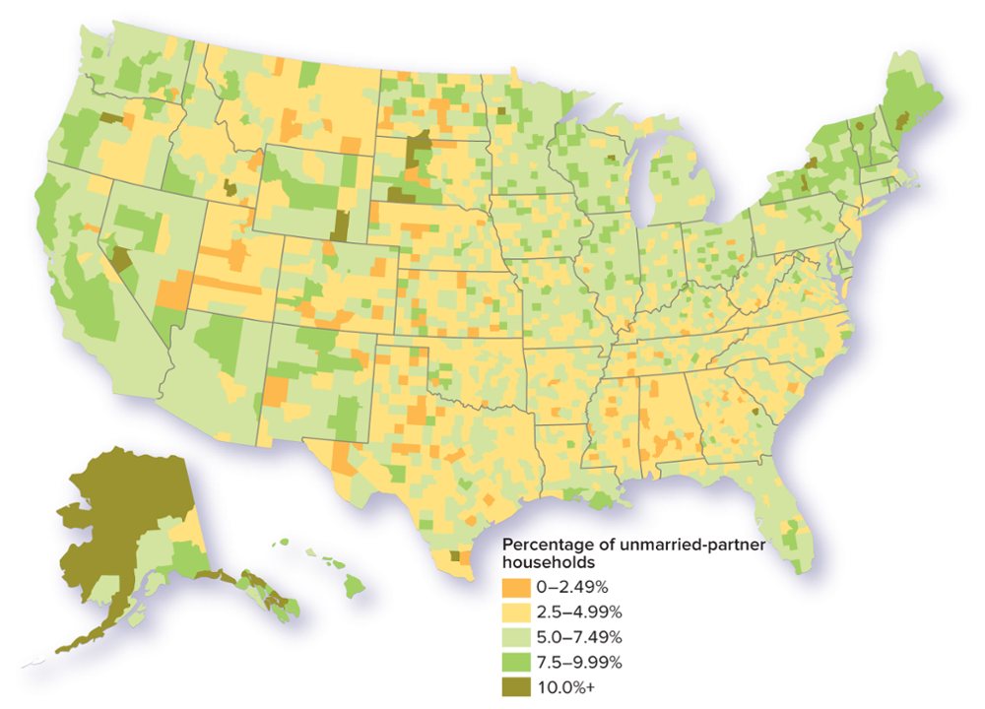
Unmarried-Couple Households by State
Access the text alternative for slide images.
Source: U.S. Census Bureau 2015b:Table 11009.

Slide 36
Remaining Single
Roughly 20 percent of adults aged 25 and older have never married.
A variety of factors help explain this trend:
Rising cohabitation rates.
Waiting longer to marry.
Of those who have never married, 14% do not want to marry.
People who remain single have stronger connections to parents, siblings, friends, and neighbors; and they may experience more personal growth and a greater sense of autonomy and self-determination.

Slide 37
Remaining Child-Free
There has been a significant increase in childlessness in the United States.
According to census data, 15.9% of women aged 40 to 50 have never had children.
Nearly one-third of millennials report they do not want to have children.
Economic considerations have contributed to this shift in attitudes.

Slide 38
Divorce 1
Sociologist Philip Cohen projects that based on current rates, 52.7% of people who marry today will divorce before one of the partners dies.
The longer a couple is married, the more the likelihood drops.
Divorce rates have fallen steadily since the 1980s.
Young people today marry more cautiously but then are more likely to stay together.
Divorced people often remarry.
About 63% in the U.S. have remarried.
Women are less likely to remarry.

Slide 39
Divorce 2
In the U.S., a variety of factors have contributed to a growing social acceptance of divorce.
Less restrictive divorce laws.
Increased family income.
More opportunities for women.
There is significant sociological debate on the effects divorce has on children.
Divorce can have substantial and long-lasting negative effects (Wallerstein, Lewis, and Blakeslee 2000).
Children can benefit from divorce if it lessens their exposure to conflict (Amato and Booth 1997).

Slide 40
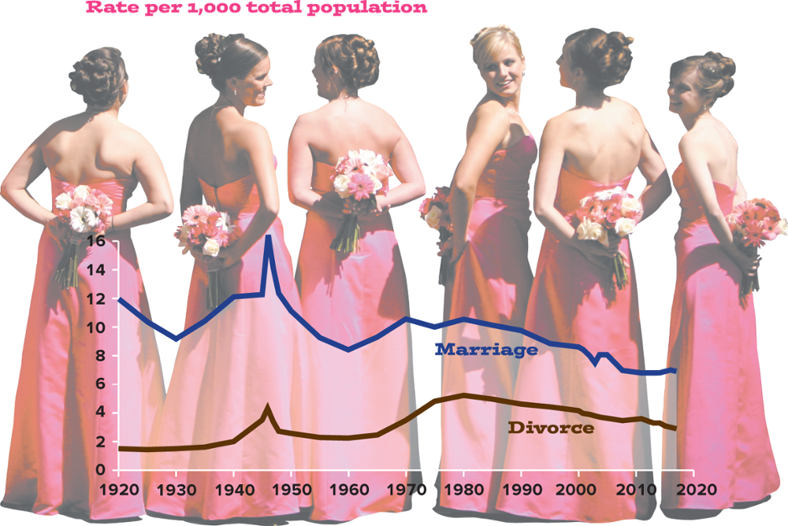
Trends in Marriage and Divorce in the United States
Sources: Centers for Disease Control and Prevention 2018a; Tejada-Vera and Sutton 2010; U.S. Census Bureau 1975:64. Photo: TriggerPhoto/E+/Getty Images
Access the text alternative for slide images.

Slide 41
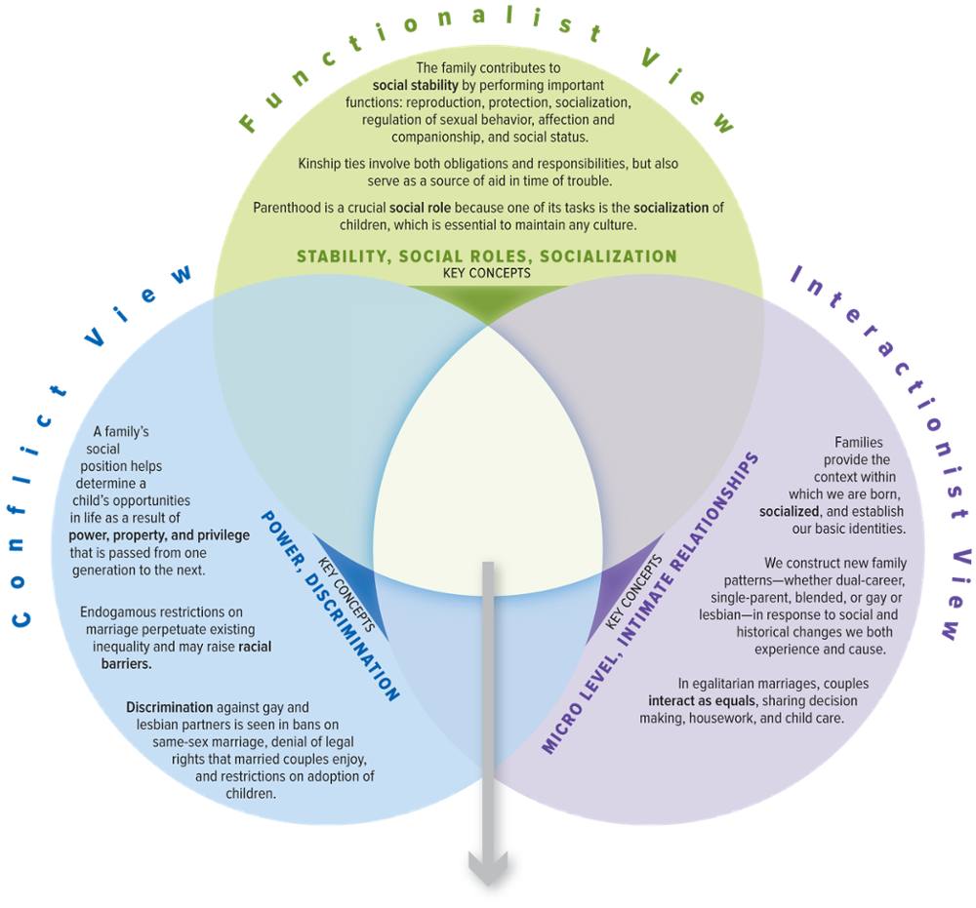
SOC VIEWS on Families
Access the text alternative for slide images.

Slide 42
Make the Connection
How would each perspective shed light on the use of online dating services and apps, such as Tinder and Bumble?
Take a look at the “U.S. Households by Family Type, 1940 to 2018” graph. What factors would each perspective focus on to explain the changes over the years?
Why does a functionalist definition of what the family does provide more insight into families today than trying to define what it is?
Who rules in your family? Would a functionalist, conflict, or interactionist perspective best describe your family dynamics?

Slide 43
End of Main Content

Slide 44
Accessibility Content: Text Alternatives for Images

Slide 45
U.S. Households by Family Type, 1940 to 2018 - Text Alternative
Return to parent-slide containing images.
The horizontal axis represents the years from 1940 to 2020, with an interval of 10 years. The vertical axis ranges from 0 to 80, in increments of 10. The graph infers the following data. Married couple families: It starts at 80 in the year 1940 and gradually decreases to 50 in 2020. Female-headed families: It starts at 10 in the year 1940 and stays steady between 8 and 12 till the year 2020. Female householders: It starts at 5 in the year 1940 and gradually increases to 15 in 2020. Male householders: It starts at 4 in the year 1940, gradually decreases to 2 in 1970, and increases to 5 in 2020. Male-headed families: It starts at 4 in the year 1940 and gradually increases to 15 in the year 2020.
Return to parent-slide containing images.

Slide 46
Patterns of Interracial Marriage - Text Alternative
Return to parent-slide containing images.
The column and row headers of the table contain husband and wife belonging to 3 different ethnicities. The table infers the following data (number in thousands). White husband, White wife: 51,164; White husband, Black wife: 245; White husband, Asian wife: 763; Black husband, White wife: 411; Black husband, Black wife: 4,462; Black husband, Asian wife: 83; Asian husband, White wife: 273; Asian husband, Black wife: 11; Asian husband, Asian wife: 4,052.
The first graph represents percentage of husbands with same-race wife: White, 96.7 percent; Black, 88.0 percent; and Asian, 92.7 percent. The second graph represents percentage of wives with same-race husband: White, 97.8 percent; Black, 93.6 percent; and Asian, 81.9 percent.
Return to parent-slide containing images.

Slide 47
Living Arrangements of Children - Text Alternative
Return to parent-slide containing images.
Each pie chart contains 4 family types. The first pie chart representing all children infers the data in the following format: year: family type, and percentage. Year 1960 and 1980: Two-parent families, 87.7 percent; one-parent families, maintained by mother, 8.0 percent; one-parent families, maintained by father, 1.1 percent; and no parents, 3.2 percent. Year 2018: Two-parent families, 69.1 percent; one-parent families, maintained by mother, 22.2 percent; one-parent families, maintained by father, 4.4 percent; and no parents, 4.3 percent.
The second pie chart representing African American children infers the data in the following format: year: family type, and percentage. Year 1960 and 1980 : Two-parent families, 67.0 percent; one-parent families, maintained by mother, 19.9 percent; one-parent families, maintained by father, 2.0 percent; and no parents, 11.1 percent. Year 2018: Two-parent families, 39.7 percent; one-parent families, maintained by mother, 48.1 percent; one-parent families, maintained by father, 5 percent; and no parents, 7.1 percent.
The third pie chart representing White children infers the data in the following format: year: family type, and percentage. Year 1960 and 1980 : Two-parent families, 90.9 percent; one-parent families, maintained by mother, 6.1 percent; one-parent families, maintained by father, 1.0 percent; and no parents, 1.9 percent. Year 2018: Two-parent families, 74.6 percent; one-parent families, maintained by mother, 17.4 percent; one-parent families, maintained by father, 4.4 percent; and no parents, 3.6 percent.
The fourth pie chart representing Hispanic children infers the data in the following format: year: family type, and percentage. Year 1960 and 1980 : Two-parent families, 75.4 percent; one-parent families, maintained by mother, 19.6 percent; one-parent families, maintained by father, 1.5 percent; and no parents, 3.5 percent. Year 2018: Two-parent families, 67 percent; one-parent families, maintained by mother, 24.9 percent; one-parent families, maintained by father, 4 percent; and no parents, 4.2 percent.
Return to parent-slide containing images.

Slide 48
Approval of Same-Sex Marriage by Age - Text Alternative
Return to parent-slide containing images.
The horizontal axis represents the years from 2003 to 2019, with an interval of 1 year. The vertical axis represents approval of same-sex marriage in percentage. Silent generation (1928 to 1945): It starts at 17 percent during the year 2003 and it gradually increases to reach 40 percent in 2019. Generation X (1965 to 1980): It starts at 40 percent during the year 2003 and gradually increases to reach 63 percent in 2019. Baby boomers (1946 to 1964): It starts at 33 percent during the year 2003 and gradually increases to reach 53 percent in 2019. Millennials (1981 or later): It starts at about 52 percent during the year 2003, drops to 44 percent during the year 2004, and gradually increases to reach 75 percent in the year 2019. All the data is approximated.
Return to parent-slide containing images.

Slide 49
Population in Multigenerational Households - Text Alternative
Return to parent-slide containing images.
The horizontal axis represents the years from 1900 to 2016, with an interval of 10 years till 2010 followed by 2016. The vertical axis represents the percentage and it ranges from 0 to 30, in increments of 5. The graph infers the data in the following format: year, percentage of multigenerational households. 1900, 23.7 percent; 1920, 22.9 percent; 1940, 24.7 percent; 1960, 15 percent; 1980, 12.1 percent; 2000, 15.1 percent; and 2016, 20 percent.
Return to parent-slide containing images.

Slide 50
Unmarried-Couple Households by State - Text Alternative
Return to parent-slide containing images.
The map infers the following data. The percentage of unmarried-partner households ranging between 5.0 and 7.49 is predominant throughout the country and next dominant percentage ranges between 2.5 and 4.99 and it falls in the West, western regions of Midwest, eastern regions of Southwest, and in the Southeast. The percentage of unmarried-partner households ranging between 0 and 2.49 is scattered in the West, western regions of Midwest, eastern regions of Southwest, and in the Southeast. The percentage of unmarried-partner households ranging between 7.5 and 9.99 is predominant in the Northeast, and scattered in the West, Southwest and Midwest. The percentage above 10 is very minimal and most regions of the Alaska fall under this category. Few small regions in West, Midwest, and Northeast also fall under this category.
Return to parent-slide containing images.

Slide 51
Trends in Marriage and Divorce in the United States - Text Alternative
Return to parent-slide containing images.
The graph is inscribed on a photograph of 6 bridesmaids facing backwards and holding a bouquet of flowers behind them. The horizontal axis represents the years from 1920 to 2020, with an interval of 10 years. The vertical axis represents rate per 1,000 total population and it ranges from 0 to 16, in increments of 2. The rate for marriage starts at 12 in the year 1920, decreases to 9 in 1930, increases again to 12 during 1940, and increases steeply to 16 in 1945. It then decreases steeply to 8 in the year 1960, increases to 11 in 1980, and gradually decreases to 7 in 2020. The rate for divorce starts approximately at 2 in the year 1920, increases to 5 in 1946, and gradually decreases to 2 in 1960. It again increases to 5 in the year 1980 and finally decreasing to 3 in 2020. All the data is approximated.
Return to parent-slide containing images.

Slide 52
SOC VIEWS on Families - Text Alternative
Return to parent-slide containing images.
It consists of 3 views: Conflict view, functionalist view, and interactionist view. Conflict view: A family’s social position helps determine a child’s opportunities in life as a result of power, property, and privilege that is passed from one generation to the next. Endogamous restrictions on marriage perpetuate existing inequality and may raise racial barriers. Discrimination against gay and lesbian parents is seen in bans on same-sex marriage, denial of legal rights that married couples enjoy, and restrictions on adoption of children. The key concepts of conflict view are power and discrimination.
Functionalist view: The family contributes to social stability by performing important functions: reproduction, protection, socialization, regulation of sexual behavior, affection and companionship, and social status. Kinship ties involve both obligations and responsibilities, but also sever as a source of aid in time of trouble. Parenthood is a social role because one of its tasks is the socialization of children, which is essential to maintain any culture. The key concepts of functionalist view are stability, social roles, and socialization.
Interactionist view: Families provide the context within which we are born, socialized, and establish our basic identities. We construct new family patterns—whether dual-career, single-parent, blended, or gay or lesbian—in response to social and historical changes we both experience and cause. In egalitarian marriages, couples interact as equals, sharing decision making, housework, and child care. The key concepts of interactionist view are stability, social roles, and socialization.
Return to parent-slide containing images.

